Slide 1

Spark application and Life cycle

Slide 2
Spark application and Life cycle
A life cycle consists of several stages
Environment setup
Application development
Job submission
Task execution
Monitoring and debugging
Job completion
Cleanup

Slide 3
Environment setup: example for a PySpark app
On-prem server, Managed Service or Serverless approach
e.g. Cloudera on-prem, AWS EMR (AWS-managed), AWS Glue (fully serverless)
Requirement of Python 3.6+
Recommended Java 8
Requirement of Apache Spark
Setup of environment variables; i.e. path to Java and Spark installations
Install PySpark using pip

Slide 4
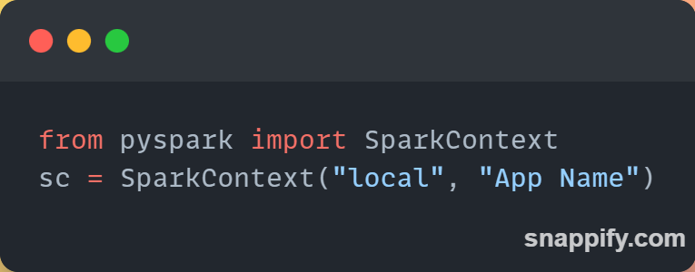
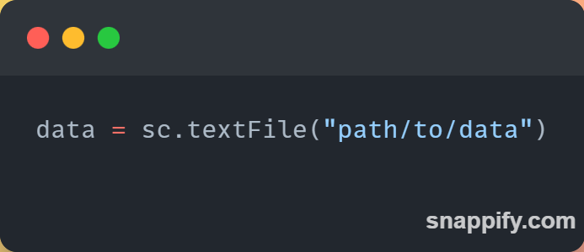
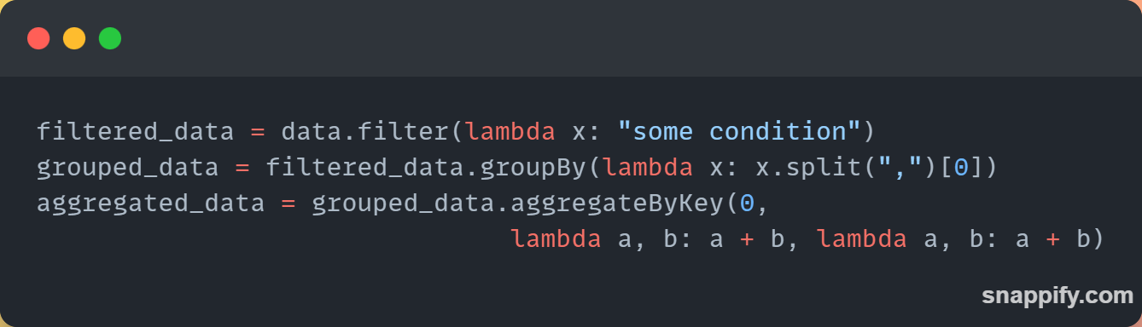
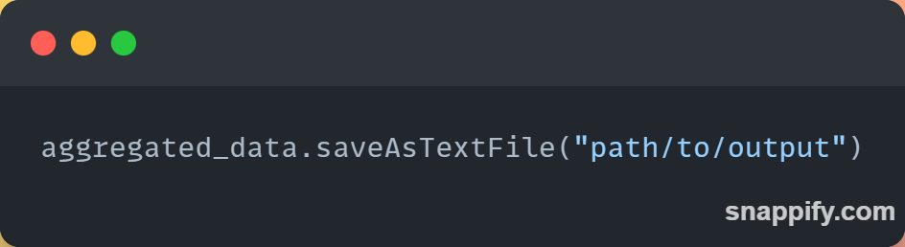
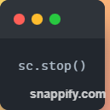
App Development - SC example
Create a SparkContext
Load Data into a Spark RDD
Transform and process data
Save results
Stop SparkContext

Slide 5
Job Submission
Submitting a PySpark application to a Spark cluster
Interactive mode
Pyspark shell is a way to test code, executions are automatically submitted to spark cluster
Batch Mode
Typically in Python script and submitted using spark-submit, doing this packages the application code in Jar file

Slide 6
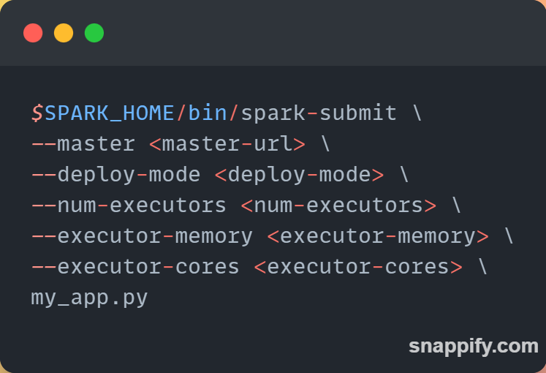
Job Submission
Regardless of mode
Define the PySpark application code
Package code
Configure Spark Cluster
Submit your PySpark using either pyspark or spark-submit

Slide 7
Next…
Environment setup
i.e. for Spark session
Application development
Job submission
Task execution
Monitoring and debugging
Job completion
Cleanup

